Slide 1
Unit 5 - Energy
Nonrenewable vs. Renewable

Slide 2
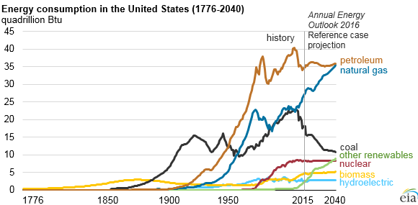
How has our energy use changed over time?
www.eia.gov/

Slide 3
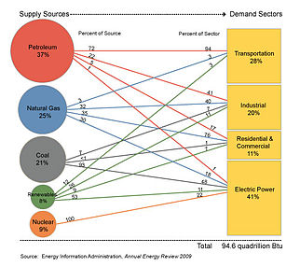
Types of energy:
Non-renewable (fossil fuels): coal, oil, natural gas
Alternative: hydro, biomass (wood, biofuel), geothermal, nuclear
Renewable: wind, solar

Slide 4
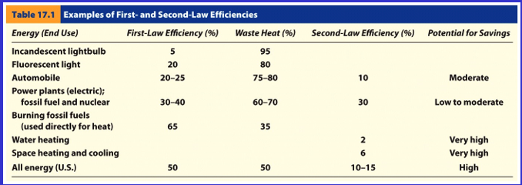
Review:
EROI
Best First
2nd law of thermodynamics (energy goes from usable form to less usable form)
Efficiency
1st law – how much energy do you get regardless of quality
2nd law – how well-matched the energy use is with quality

Slide 5
Fossil Fuels – oil, coal, natural gas How were they formed?

Slide 6
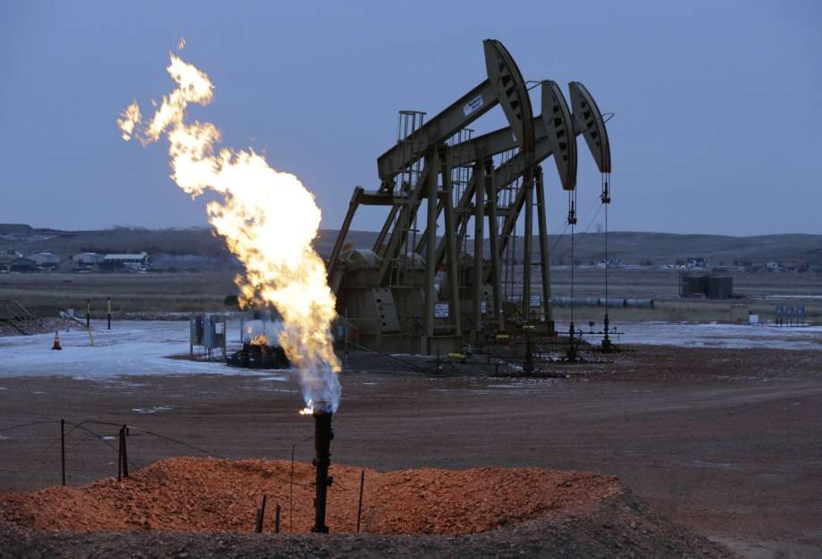
Natural gas - methane
Used by Chinese in 500 BC
Manufacturing process brought to US in 1816.
1821 – first gas well near Lake Erie

Slide 7
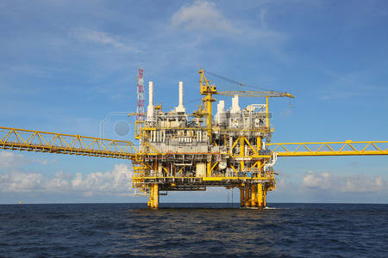
How do we get it?
Look familiar? Just like drilling for oil…..

Slide 8
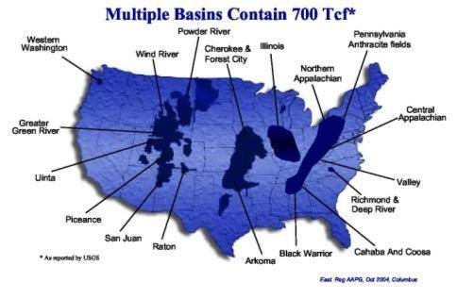
Where is it found and what is it used for?
Tcf = trillion cubic feet
We use about 27.31 tcf per year.
End Use | Amount (Tcf) | Share of total
Electricity | 9.67 | 35%
Industrial | 7.53 | 28%
Residential | 4.61 | 17%
Commercial | 3.20 | 12%
Plant Fuel Consumption | 15.59 | 2%
Pipeline and distribution | 0.67 | 2%
Vehicle Fuel | 0.04 | 0.1%

Slide 9
How much is left?
US Energy Information Administration estimated that there was ~2,474 Tcf of natural gas in the US. Do the math! If consumption stays the same ~ 93 years.

Slide 10
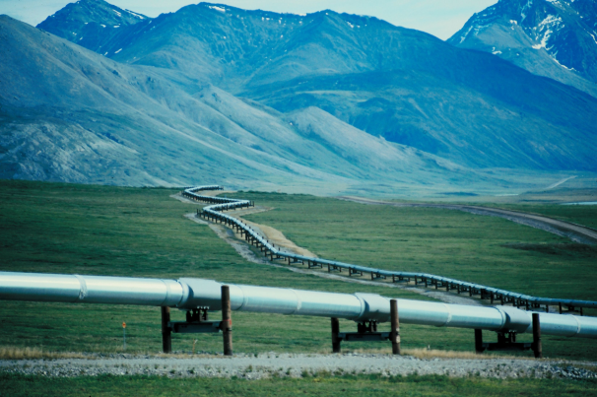
How it’s transported…
210 gas pipeline systems
305,000 miles

Slide 11
But what about hydrofracking?

Slide 12
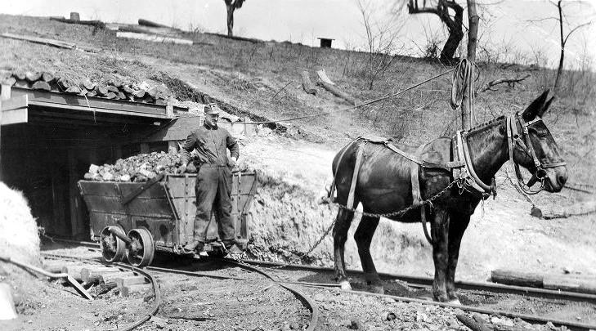
History of Coal
Mid 1700’s- first mines.
Provided more heat per pound than wood and at a smaller volume
More portable than wood

Slide 13
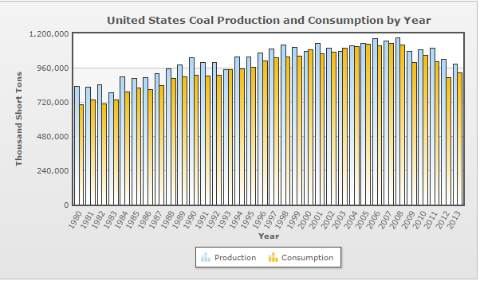
Facts…
Over 90% of coal use is used to generate electricity
Known reserves constitute 26% of world’s supply
Coal is measured in tons, thousand short tons, and BTUs

Slide 14
How much coal is there?
In 2014 - 1 billion short tons was produced.
The estimated recoverable reserves should last ~256 years!

Slide 15
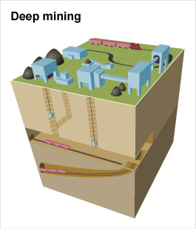
How do we get the coal?
Up to ~ 200 feet below surface
Up to ~ 1000 feet below surface

Slide 16
Where does it come from?

Slide 17
How about this surface mining?
Involves CLEARING, BLASTING, DIGGING, VALLEY FILLS, PROCESSING and RECLAMATION

Slide 18
Surface Mining Lab

Slide 19
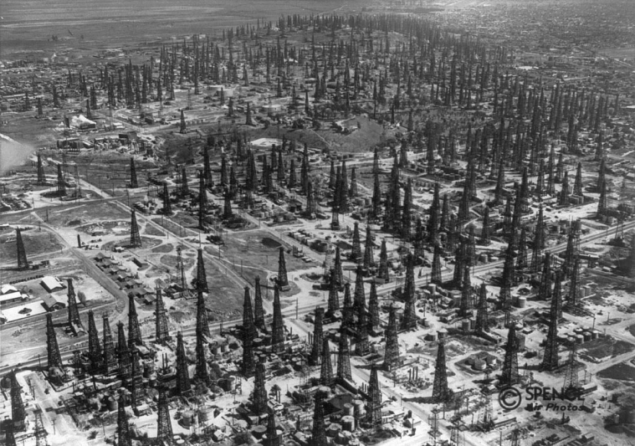
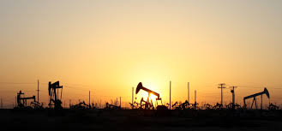
History of Oil
1859 – first oil well in Titusville, PA
1930 – Los Angeles, CA
By 1950 the US produced 50% of the world’s oil, dominated the market, and set prices (gas $.19/gal)

Slide 20
Oil – Hubbert’s Peak
In 1956 Shell Geophysicist M. King Hubbert predicted that oil production in the US would peak by 1970. He was the target of ridicule then and still today. Was he right?

Slide 22
But what about???
Think EROI and Best First!

Slide 23
So how much oil IS there? How much is left?
US daily petroleum consumption: 19.1 million barrels/day (source: www.eia.gov)
Alaska’s ANWR- how much is there?
DOE – 5 billion barrels
Heritage Foundation – 16 billion barrels
USGS – 10.4 billion barrels
Do the math! (Assumption: consumption remains constant)
If we go with the USGS estimate – 544 days (1.5 years)
Heritage – 2.3 years
DOE - .75 years
Why don’t we just find more US oil? Think Best First and EROI!!

Slide 24
World Recoverable Reserves (best guess – and think about the reasons why)…and do the math!

Slide 25
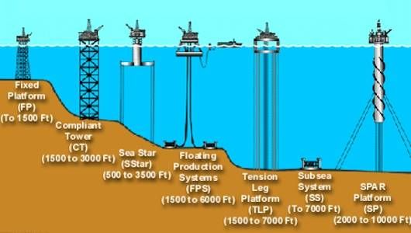
But what about OFFSHORE oil?
2006 – BIG oil discovery in Gulf of Mexico – 3-15 billion gallons – do the math!
We currently get about 22 million barrels a day
Again – think Best First and EROI

Slide 26
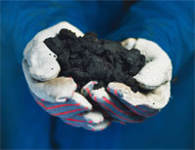
What about oil in shale and tar sands?
Has to be mined and processed to extract the oil = more expensive!
Estimates in Green River Formation – 1.2-1.8 TRILLION barrels! (but not all in places we could access)….so say moderate 800 billion barrels (116 years!)

Slide 27
Keystone Pipeline – what’s the issue?

